Slide 1
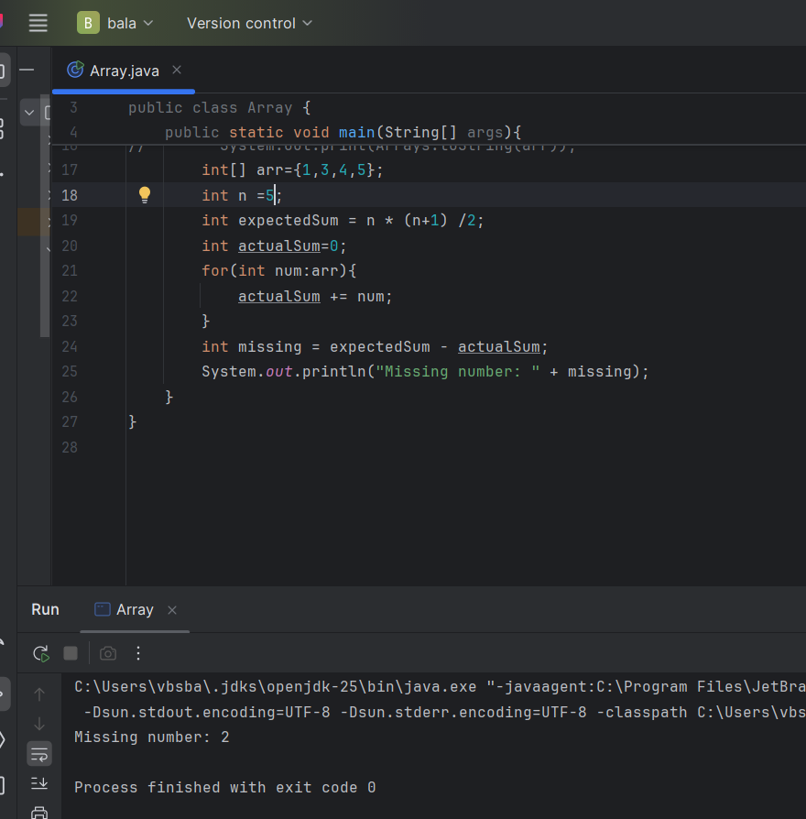
Missing Numbers

Slide 2
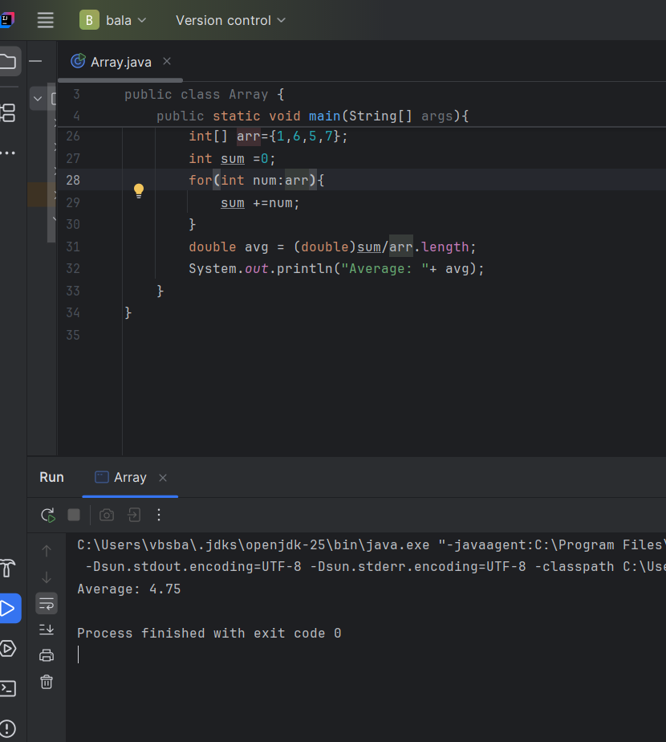
Average Sum

Slide 3
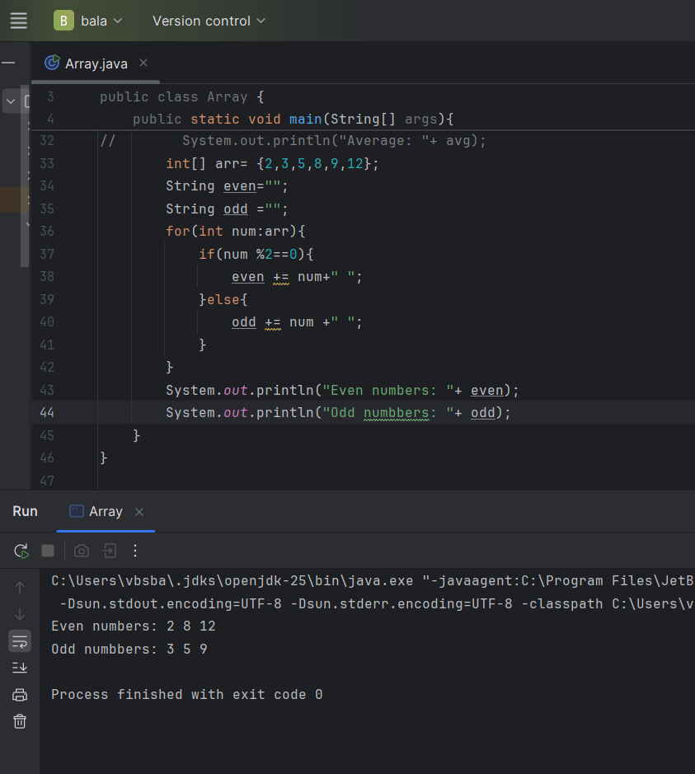
Printing Even and odd elements from an Array

